Slide 1
Economic Impacts of COVID-19 on Major U.S. States
Geovanni Rubio
Jordan Thomas
Mignon Gordon
Modester Tembo

Slide 2
Project Outline
This project examines the economic consequences of COVID-19 in five key U.S. states:
California, Florida, New York, Texas, and Washington
These states were selected due to their differing approaches to policy regarding COVID.
Our analysis will examine the following variables:
Unemployment
GDP growth and trends
Personal Income per Capita

Slide 3
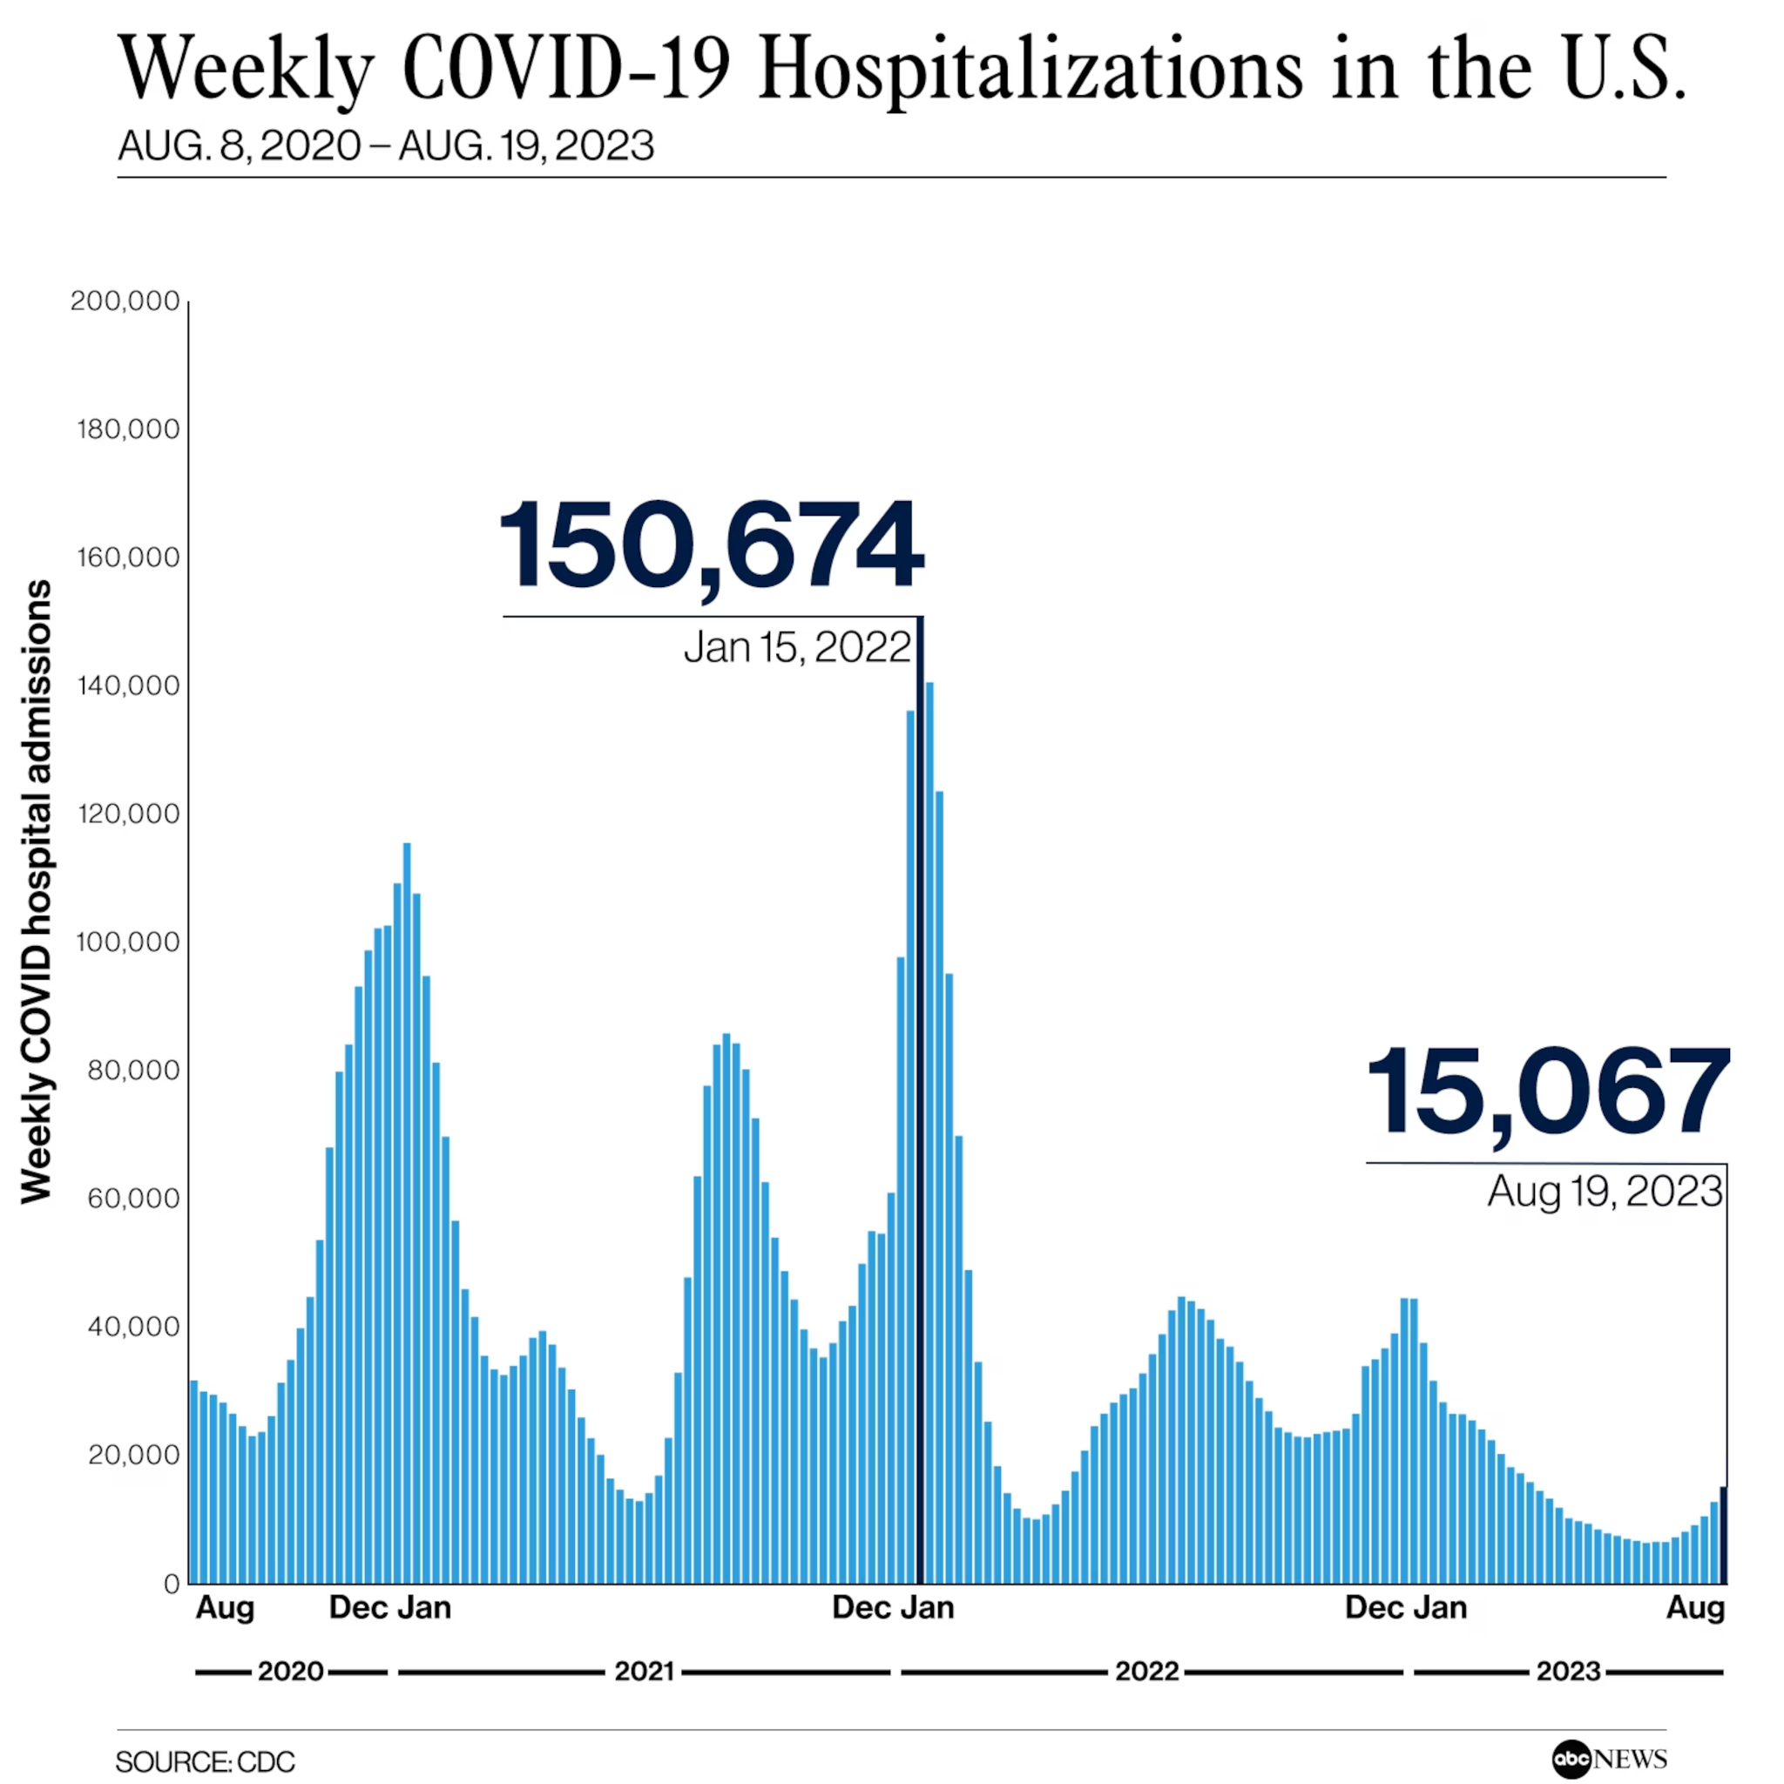
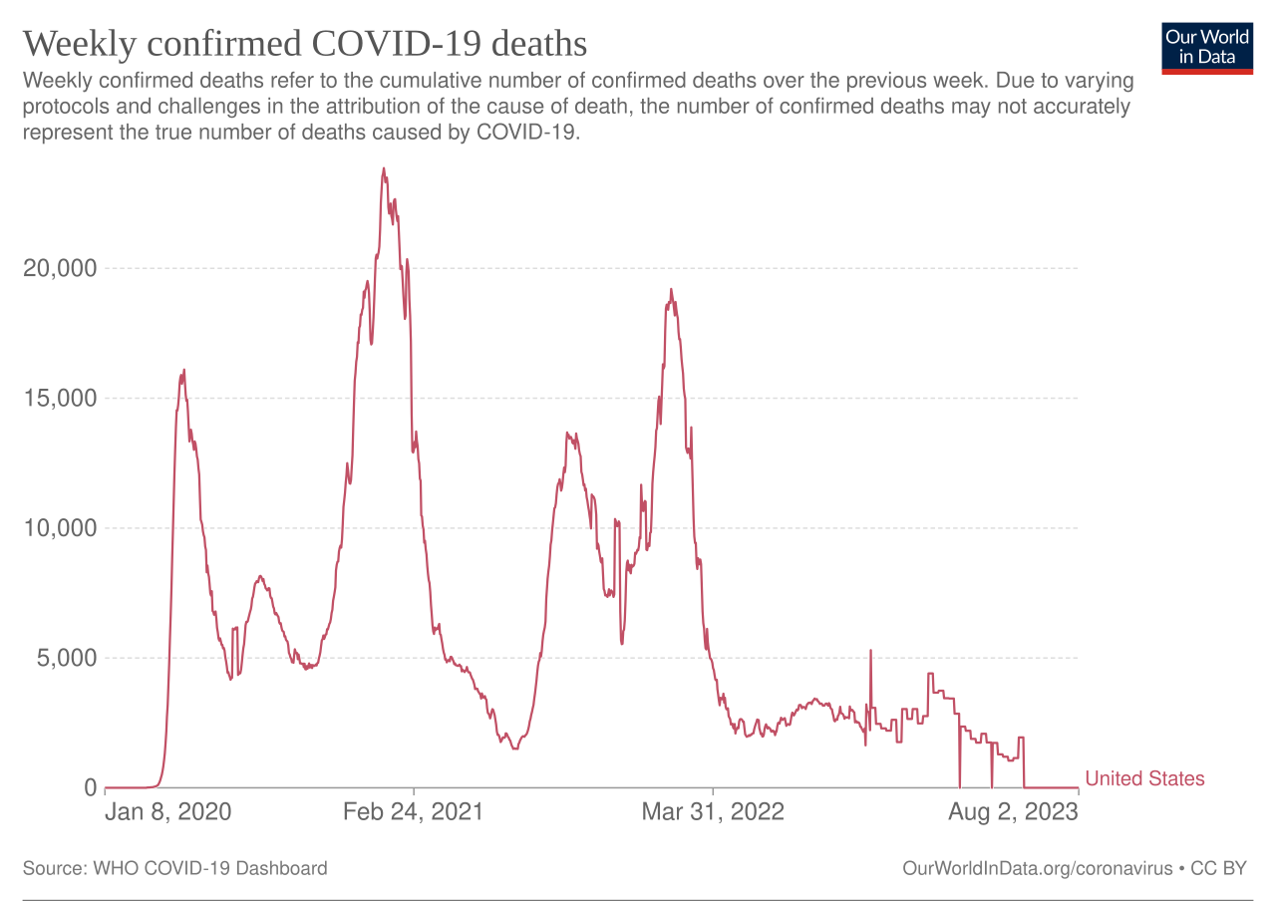
COVID’s Public Health Impact

Slide 4

State Responses to the COVID-19 Pandemic

Slide 5
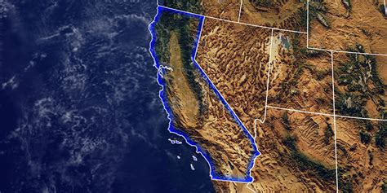
California (Strict State)
Stay at home ordered 3/19/20. Officially lifted 1/25/21.
Total number of days: 312 days
Banned all public gatherings.
Lifted Ban 4/15/21 based on risk analysis tier system.
Face coverings mandatory as of 6/18/20.
Lifted Face Cover Order on 3/01/22 under certain circumstances; still required in places like public transit, health care settings, etc.
Schools reopened for in-person learning in Fall 2021.
Most COVID-19 restrictions lifted 6/15/21.

Slide 6

Florida (Lenient State)
Stay at home ordered: 4/03/20. Lifted 4/30/20, though some counties opened a couple of weeks later.
Total number of days: 27 days.
Public gatherings initially limited to 10 people or less.
Face coverings never mandated.
Schools reopened for in-person learning in Fall 2020.
Lifted all state enforced COVID-19 restrictions on businesses statewide on 9/25/20, though counties and cities are still allowed to set their own regulations.
Restaurants and bars allowed to open at full capacity.
State suspended local restrictions on 05/03/21

Slide 7
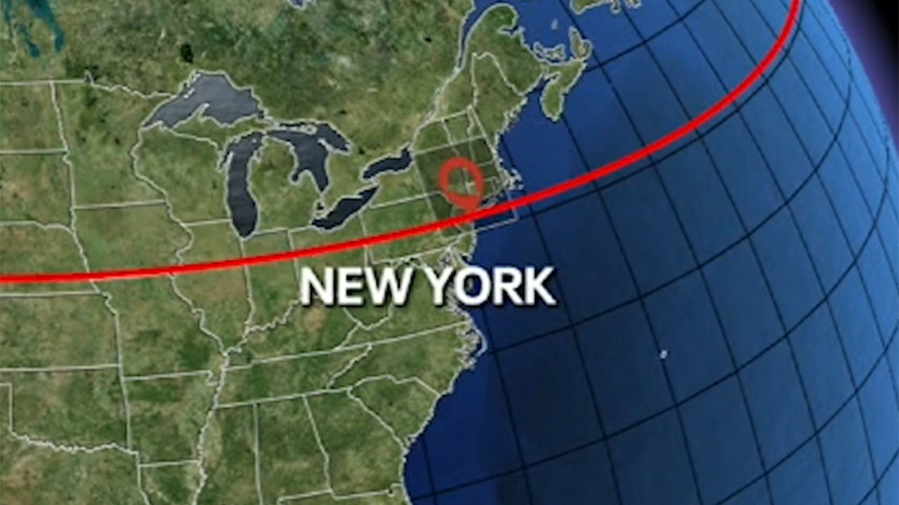
New York (Strict State)
Stay at home ordered: 3/22/20. Lifted 5/15/20.
Face coverings required in public. Mandate lifted on 2/10/22.
Banned all public gatherings.
Schools reopened for in-person learning in Fall 2021.
COVID-19 Restrictions lifted on 6/15/21.

Slide 8
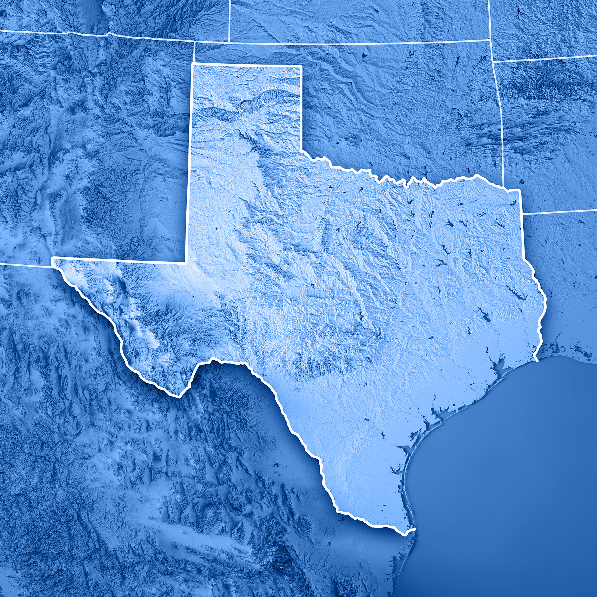
Texas (Lenient State)
Stay at home ordered: 4/02/20. Lifted 4/30/20.
Face coverings mandatory in most, but not all, counties on 7/02/20. Officially lifted on 3/02/21.
Public gatherings initially limited to 10 people or less.
Schools reopened for in-person learning in Fall 2020.
Planned reopening of businesses started in April/May 2020, but suspended as cases spiked in June/July 2020.
Businesses allowed to operate at 75% capacity on 9/17/20; all restrictions removed 3/02/21.

Slide 9
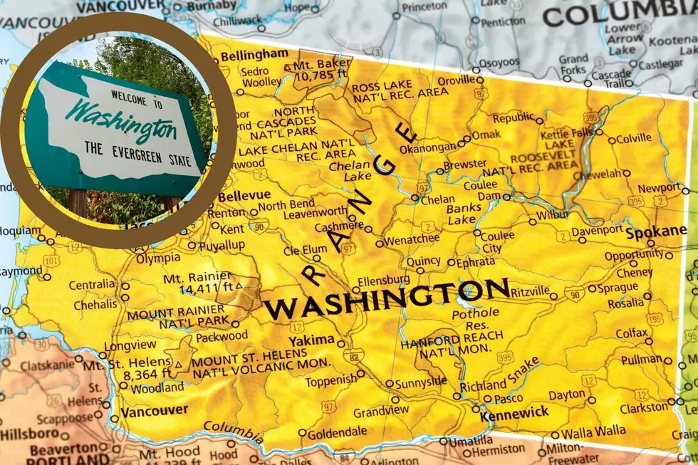
Washington (Somewhere in the Middle)
Stay at home ordered 3/23/20. Lifted 5/04/20.
Face coverings mandatory in public. Lifted 3/12/22.
Banned all public gatherings.
Dining establishments open at reduced capacity around October 2020. This changed as cases went up.
Schools reopened for in-person learning 6/30/21.
Businesses allowed to operate at full capacity: 6/29/21.

Slide 10
Research Questions
Our main question centers on whether the states with less COVID-19 restrictions (Florida and Texas) have better economic outcomes than the states with the stricter measures (California, New York, Washington).
How was GDP in these states affected through the years of 2020-2023? Did Florida and Texas perform better?
What were the unemployment patterns for these states during these years? Did Florida and Texas perform better in this metric?
Is there a relationship between GDP and Unemployment in these states?
How did the pandemic affect Personal Income per capita in these states? Was there a notable difference?

Slide 11
Data Sources & Variables
Data Sources:
Bureau of Labor Statistics (BLS) for unemployment and sectoral data
Bureau of Economic Analysis (BEA) for GDP by state and sector
Census.Gov for Personal Income Per Capita by State
Variables:
GDP
Unemployment Rates
Personal Income Per Capita

Slide 12
Methodology
Descriptive Statistics: Summary statistics (mean, standard deviation, min, max, quartiles) for GDP and unemployment rates across the selected states from 2020 to 2023.
Time Series Analysis: Examination of GDP and unemployment trends over time using line plots, comparing patterns across states.
Comparative Analysis: State-by-state comparisons using descriptive statistics and visualizations to assess the impacts of COVID-19 policies on economic sectors.
Boxplot Analysis: Used for unemployment rate data to visualize the distribution and to identify if the data follows a normal distribution, also for identifying any significant outliers.
Outlier Analysis: Unemployment and GDP rates across the states were visually assessed for outliers in boxplots and statistical summaries.
Regression Analysis: Linear regression was performed between quarterly state GDP and state unemployment rates to examine the relationships and trends across states. Scatter plots with fitted regression lines were used to visualize the correlations.

Slide 13
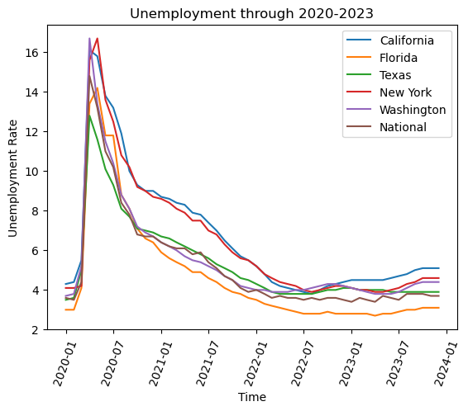
Unemployment Rates Time Series Analysis

Slide 14
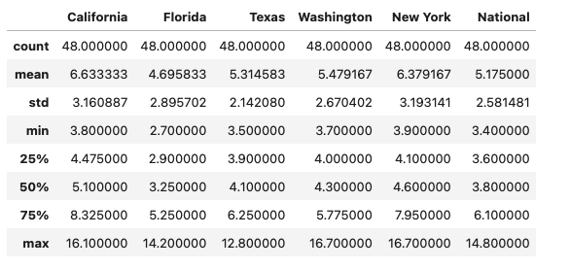
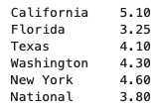
Descriptive Analysis:Unemployment

Slide 15
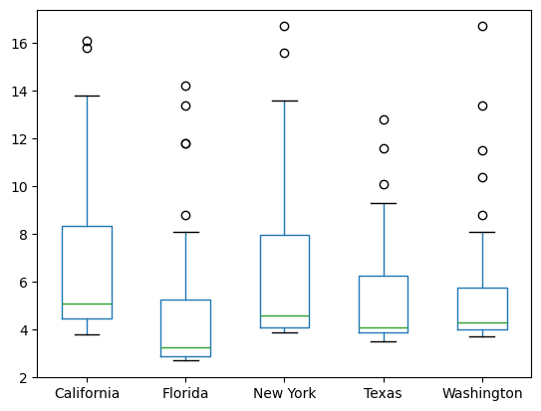
Unemployment Rates Box Plots

Slide 16
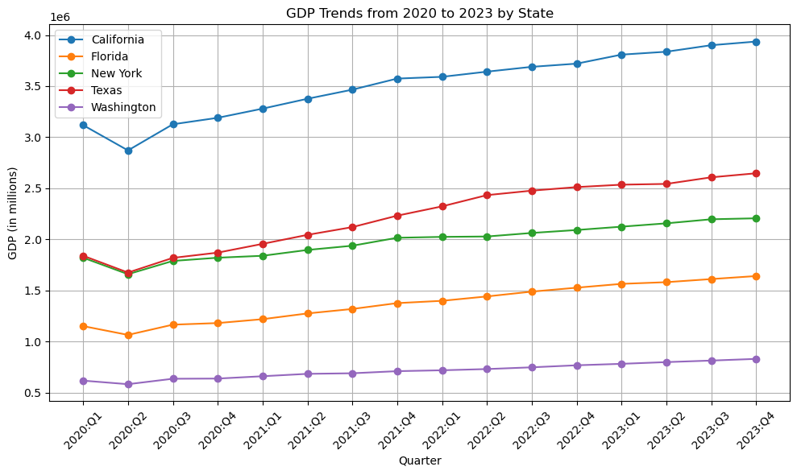
GDP Time Series Analysis

Slide 17
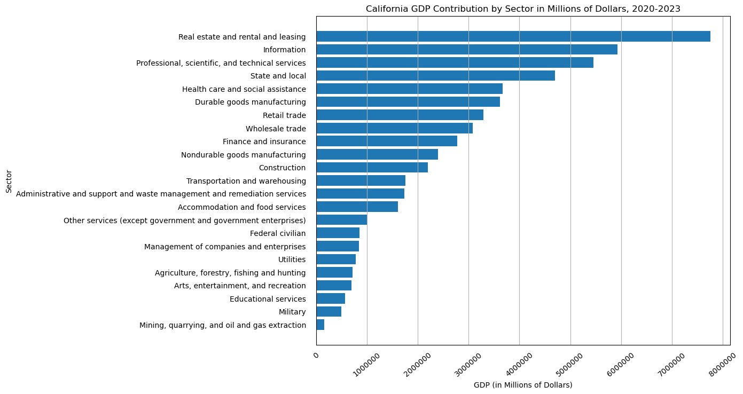
Comparative Analysis:
GDP Contribution by Sector in California

Slide 18
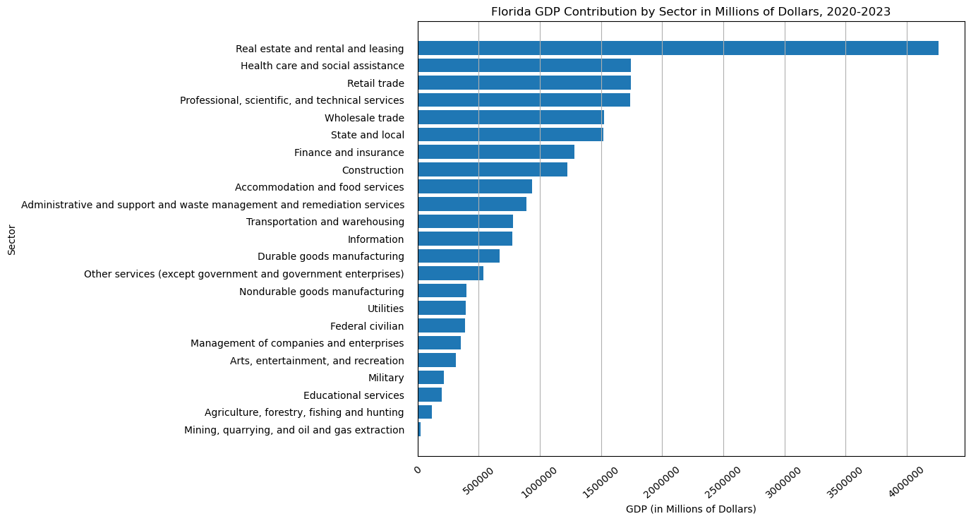
Comparative Analysis:
GDP Contribution by Sector in Florida

Slide 19
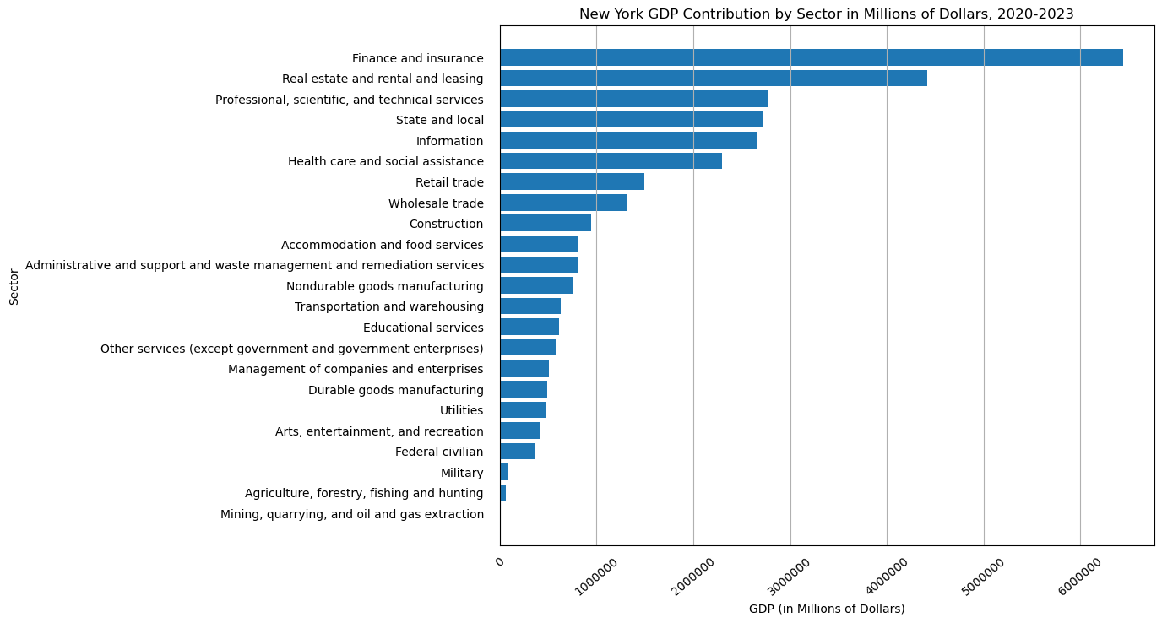
Comparative Analysis:
GDP Contribution by Sector in New York

Slide 20
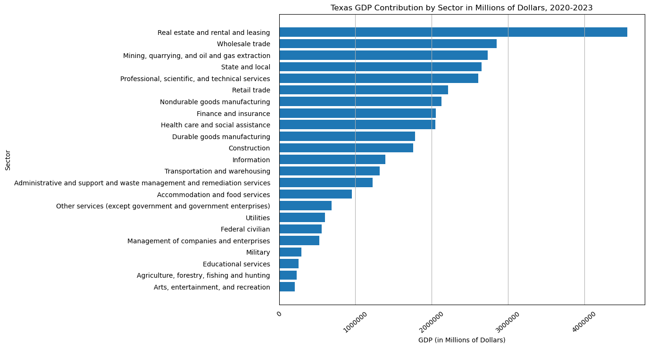
Comparative Analysis:
GDP Contribution by Sector in Texas

Slide 21
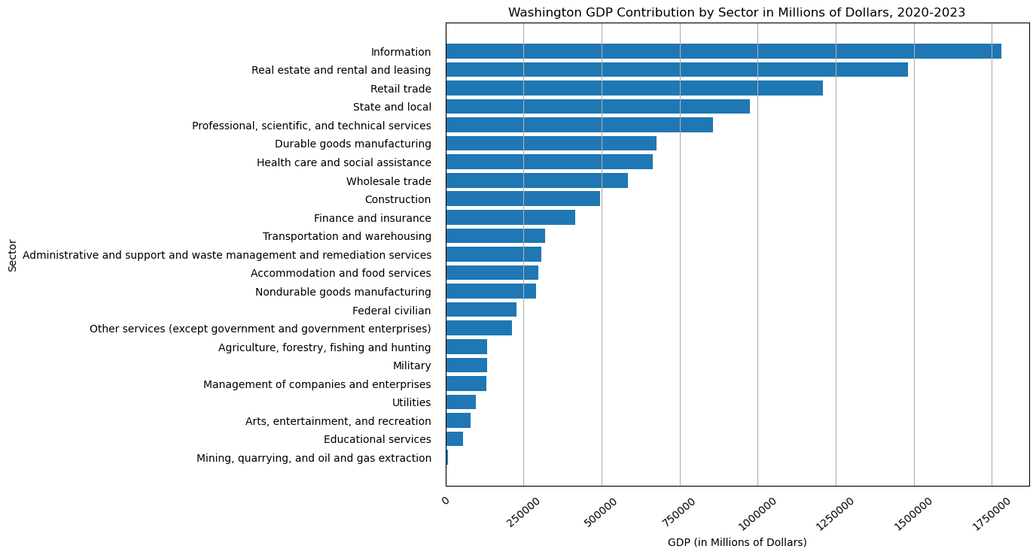
Comparative Analysis:
GDP Contribution by Sector in Washington

Slide 22
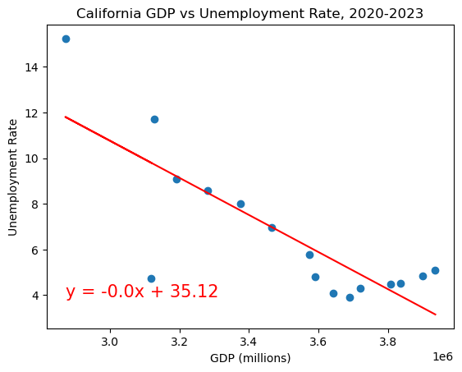
Linear Regression:
GDP vs. Unemployment in California

Slide 23
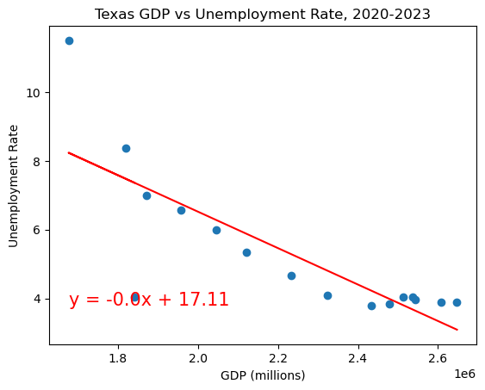
Linear Regression:
GDP vs. Unemployment in Texas

Slide 24
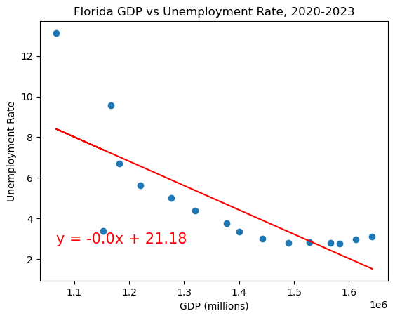
Linear Regression:
GDP vs. Unemployment in Florida

Slide 25
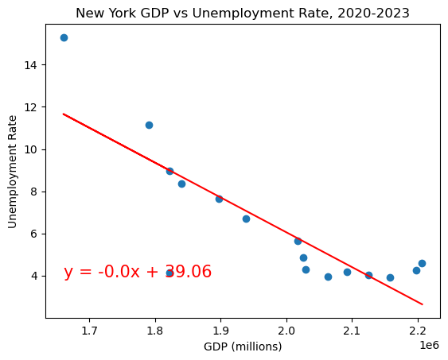
Linear Regression:
GDP vs. Unemployment in New York

Slide 26
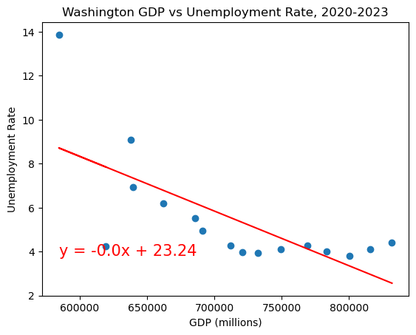
Linear Regression:
GDP vs. Unemployment in Washington

Slide 27
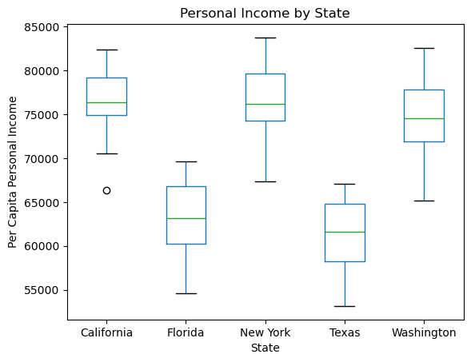
Box Plot- Personal Income By State

Slide 28
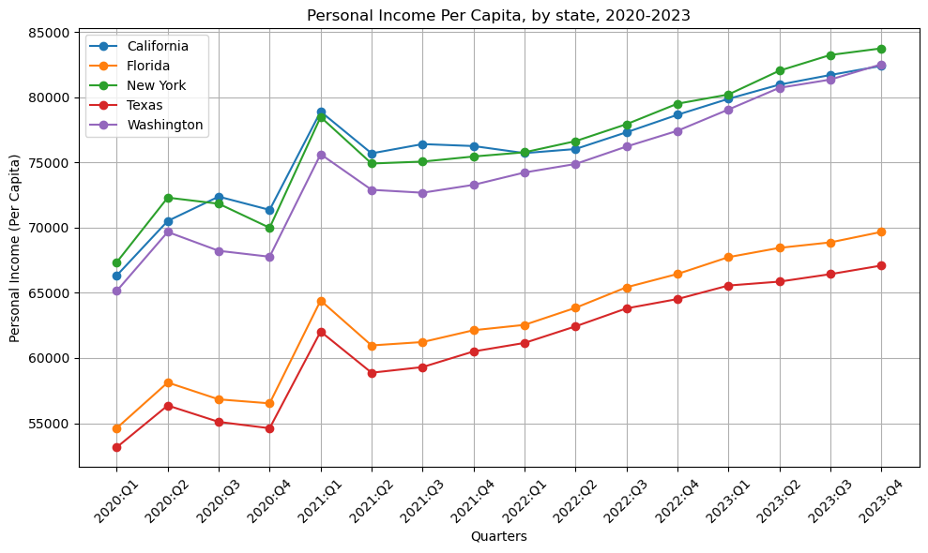
Time Series Analysis:
Personal Income Per Capita by State

Slide 29
Conclusion
GDP Trends (2020-2023):
All states experienced a GDP decline in Q2 2020, with Florida and Texas adding more to their GDP than states with stricter measures like New York and California. By 2023, lenient states showed steadier GDP growth, indicating more economic resilience throughout the pandemic.
Unemployment Patterns:
Unemployment rates sharply increased in all states on April 2020. Afterward, there was a general decline in unemployment in all states until August/September 2022, where we see more fluctuation in rates.
Florida maintained the lowest unemployment rate for the majority of 2020 - 2023. By December 2023, FL’s unemployment rate was closest to the pre-pandemic rate.
Relationship Between GDP and Unemployment:
A moderate-to-high negative correlation was observed between GDP and unemployment rates in NY and CA. This relationship was less pronounced in FL, TX and WA.
Impact on Personal Income Per Capita:
We see a lot of fluctuations in per capita Personal Income between Q1 2020 and Q1 2021. Following that, all states exhibit a gradual incline.

